Slide 1
Livestock emission analysis
Lolita Muller
Notes:
So today I’m presenting the analysis we are doing on livestock emission. I’m going to go quickly over it and then we see if you have some insights for the next steps or comments. Please if you have comments don’t hesitate to interrupt me.

Slide 2

GOAL
Developing a Method to Quantify Enteric Methane Emissions: Identifying Ingredients and Dietary Shifts That Reduce Emissions Without Compromising Productivity
ERA data : 695 goat sheep and cattle papers
Notes:
We are developing a method to estimate enteric methane emissions from livestock diets, using our ERA data. The core aim is to identify feed ingredients and dietary changes that can reduce methane emissions without compromising productivity in Africa for goat sheep and cattle

Slide 3
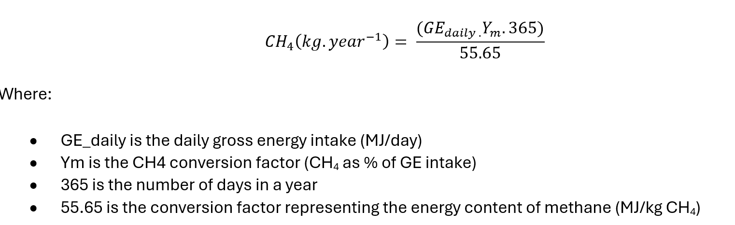
How we estimate emissions
IPCC Tier 2
Notes:
We created a reproducible pipeline to turn raw livestock feeding trial data into Tier-2–ready emission estimates. Our emission estimates follow the IPCC Tier 2 methodology using ERA feeding trials papers. We calculate methane emissions based on daily gross energy intake (GEI) and a methane conversion factor (Ym). This allows for more detailed and accurate estimations than Tier 1, by incorporating diet-specific energy values.

Slide 4
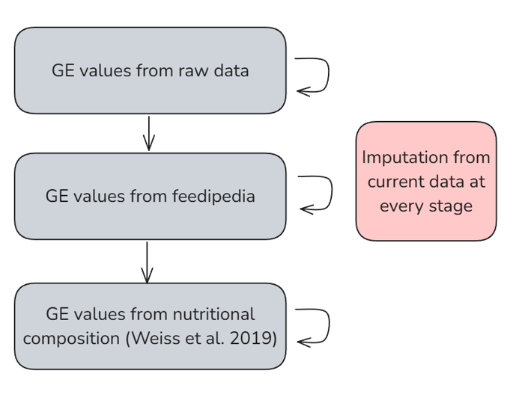

How we estimate gross energy
From raw data
Feedipedia
ILRI feed database
Proximate composition
4
Notes:
To estimate gross energy intake we implemented a five-step cascade to fill missing values:
Original study-reported GE values
Feedipedia database values
ILRI feed database
Estimate gross energy from proximate composition Weiss & Tebbe (2019) empirical equation, based on CP, EE, and ash

Slide 5

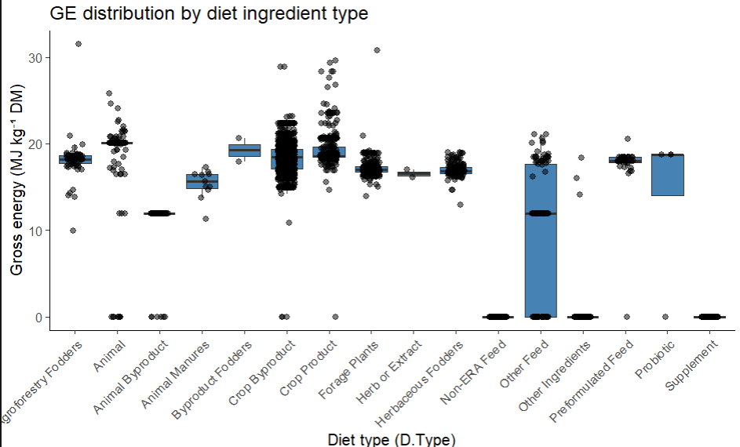
Oil rich ingredients
Non-nutritive additives
5
Notes:
Here you have our gross energy estimation depending on the category of ingredient. You’ll see that we will discuss those categories after.
So, our first question and doubt is about the formula used in IPCC tier 2 since all variable are constants except for Gross energy we are wondering if this is the best formula that we can use to calculate enteric methane emission or if there are other ways to estimate.

Slide 6
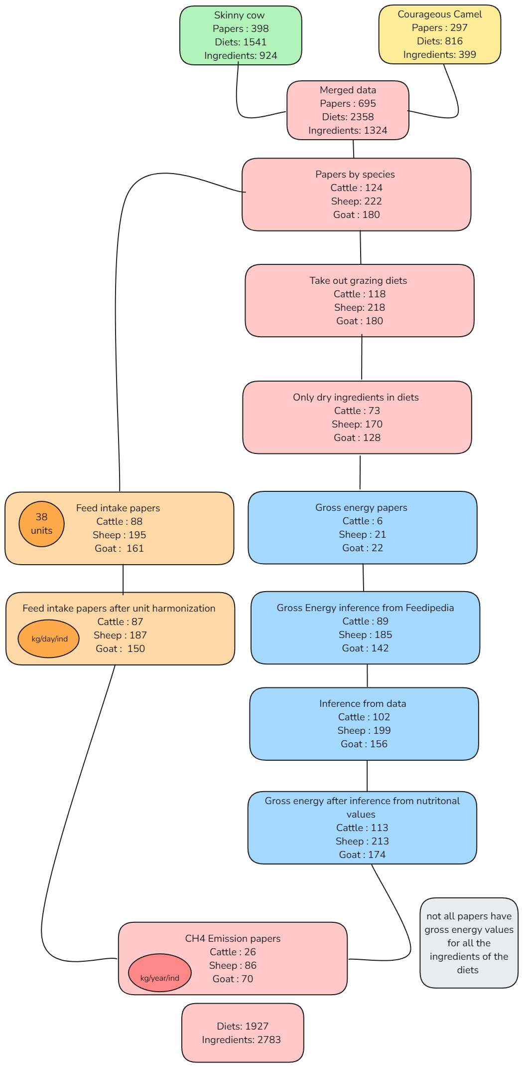
How we clean the data
No grazing experiments
Take out basal diets
6
Notes:
To ensure quality, we excluded grazing experiments—where intake can't be quantified—removed basal-only diets because most of the times we don’t have feed intake data for those, kept only ingredients with dry matter-based ingredient reporting.
With all these steps we end up with 180 papers with the right information to be able to calculate emissions.

Slide 7
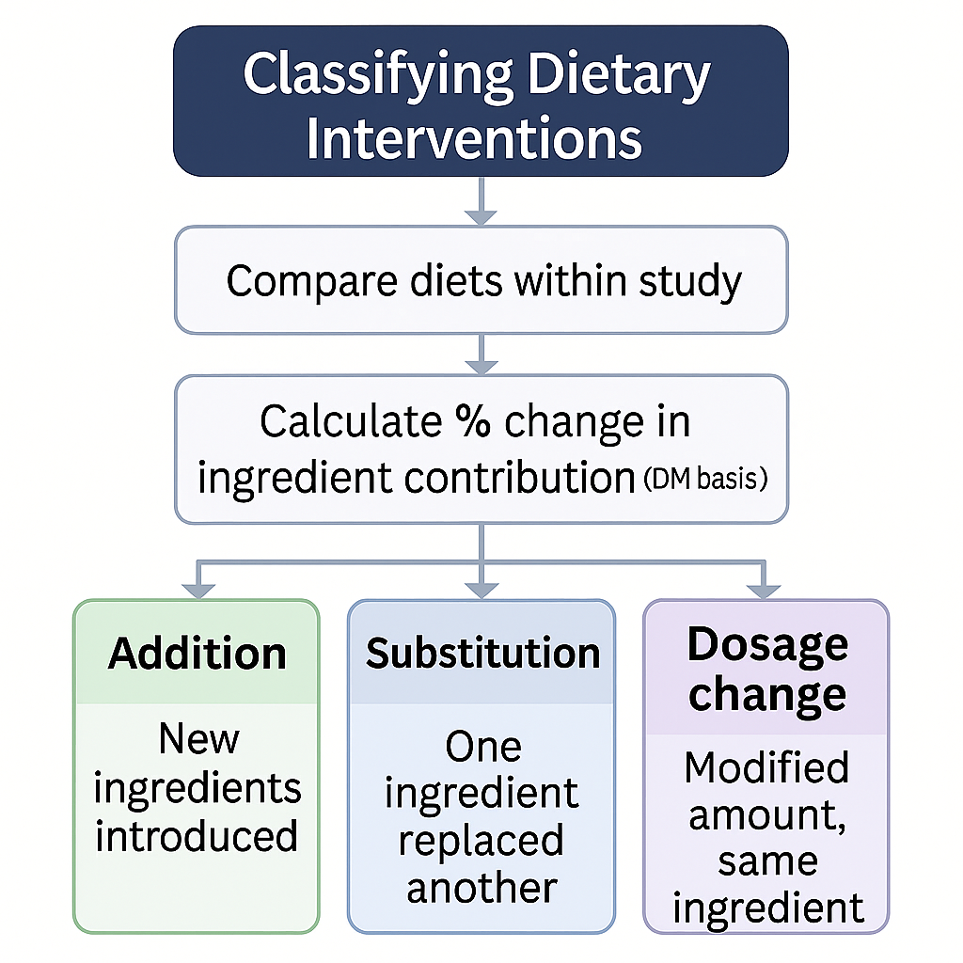
7
Notes:
To classify feeding interventions, we compared diets within each study and quantified ingredient-level changes. Note that we compared all diets to control diet but also treatment diets between each other. Based on these changes, we labeled interventions as additions, substitutions, or dosage changes. This approach captures both the type and intensity of dietary modifications, allowing structured comparisons across studies and feeding strategies.

Slide 8
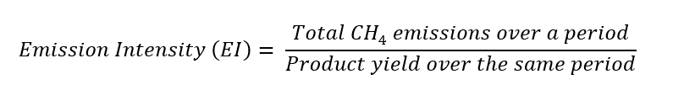
Used metrics
Raw emissions
8
Notes:
In addition to absolute CH₄ emissions, we calculate emission intensity—the amount of methane per kg of product. This metric allows us to assess productivity alongside emissions and identify interventions that are both climate-smart and maintain productivity.
So ultimately our goal would be to compare efficiency in terms of emissions when shifting diets. So for example is substetting Agroforestry fodders to grains lowers emissions intensity?

Slide 9
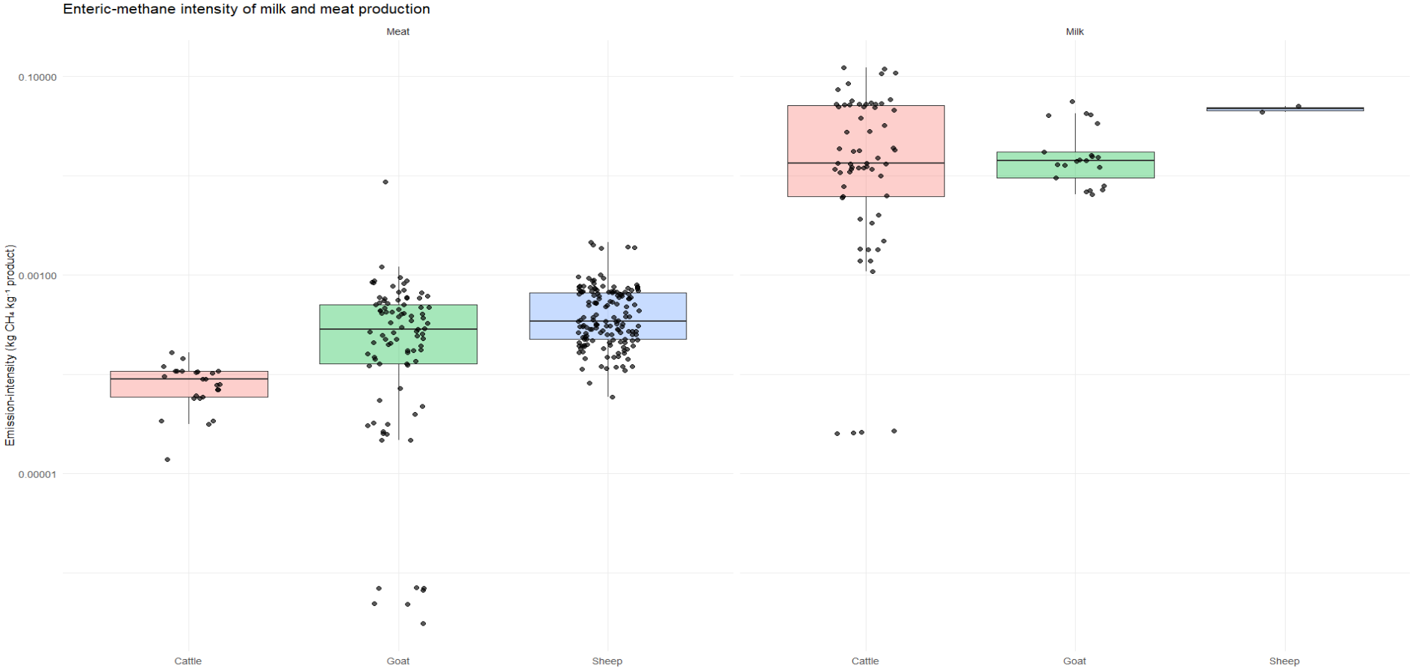
MILK
MEAT
9
Notes:
Here you have an example of a graph with emission intensity for different species and different products.
meat is much more efficient than milk in term of emissions.
So for us the ultimate goal would be to have the emission intensity information like for example when switching forages to grains and see the impact of enteric methane emission.

Slide 10
How we classify ingredients types
Feed Category | Digestibility | GE (MJ /kg DM) | NDF (% DM) | Protein (% DM) | Typical Examples
High-energy carbs | > 80 % | 17 – 19 | 10 – 20 | 8 – 12 | Maize grain, barley, wheat, molasses, cereal bran
High-energy fats/oils | > 90 % | 30 – 38 | < 5 | < 5 | Vegetable oils, tallow, protected fats
High-protein feeds | > 75 % | 18 – 20 | 10 – 30 | 35 – 50 | Soybean meal, canola meal, fish meal, distillers grains
Good-quality forages | 55 – 70 % | 16 – 18 | 40 – 50 | 12 – 20 | Young grass hay, quality silage
Poor-quality roughages | < 50 % | 15 – 17 | 60 – 75 | 3 – 8 | Straw, mature pasture, maize stover
Mineral / vitamin supplements | Highly digestible | Negligible | Negligible | Negligible | Mineral premixes, salt licks
10
Notes:
To run a meaningful emissions analysis, we first need ingredient categories that genuinely reflect how feeds drive greenhouse-gas outputs. We therefore grouped ingredients functionally—by the nutritional traits that most influence emissions:
Digestibility
Gross energy (GE)
Neutral-detergent fibre (NDF)
Crude protein
This data-driven framework gives us a consistent, transparent way to slot any feedstuff into the right bucket.
Although the framework is technically robust, its real value will be measured by how well it maps onto the realities of end users—farmers and policy-makers. It would be nice to have feedback from the field to confirm that these categories reflect actual feeding practices and to adjust them where needed, ensuring the advice we deliver is both credible and actionable.

Slide 11
Possible Improvements
Ingredient categories for pertinent analysis
Other ways to estimate emissions than IPCC Tier 2
Ym values in IPCC are from trials in New Zealand
11
Notes:
So to summarize the key things that we would need advice on :
First of all what ingredient categories would be pertinent for our analysis
We now use the IPCC Tier 2 formula to estimate enteric methane. That method gives general averages and may not capture the effect of changing feed composition. Other diet-focused equations exist, but they were developed outside Africa. We need to decide which option—IPCC Tier 2 or a diet-specific formula adapted with local data—will give the most accurate estimates for our work. I could also be that we compare different methods.
Lastly something that I did not talk about but the methane conversion factors depends on many things. They give very detailed tables in the IPCC documents but the value they give were measured for livestock in New Zealand which doesn’t seem very relevant. Edward gave us a source for cattle in Kenya giving those values so maybe you also have insights on good sources for methan conversion factor values in Africa.
THRESHOLD

Slide 12
Feedipedia and nutritional comp data update
Update of feedipedia codes (600 unique entries)
Comparison of feedipedia and raw data. When raw data is too far off (>10%) the nutritional composition was replaced with feedipedia data)
0.07% (=252 unique ingredients) of nutrition data was corrected

Slide 13
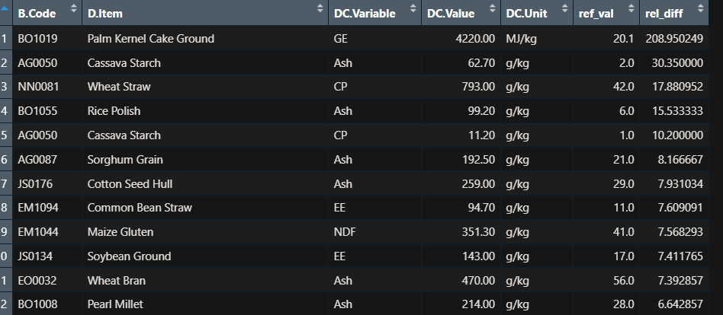
Nutritional data corrections

Slide 14
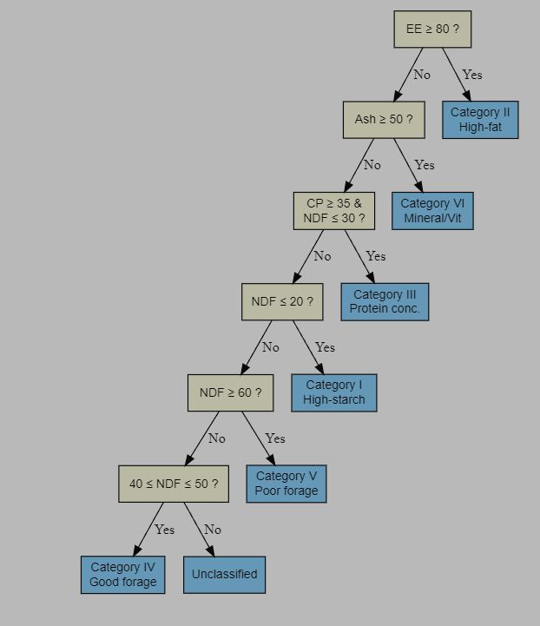
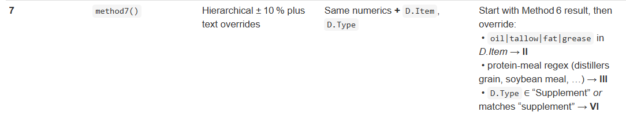
Ingredient classification
Flexible Decision tree and text parsing method is the most promising (70.9% coverage)
Ingredients and diets were classified
Offal and bran were harmonized

Slide 15
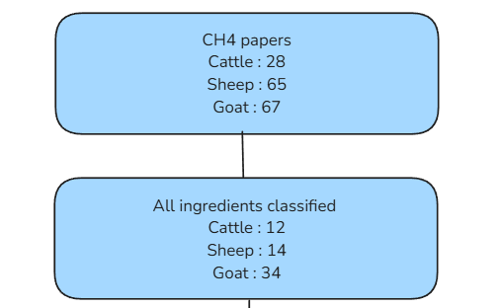
Ingredients classification
Total number of papers with ch4 and then papers where all ingredients are classified

Slide 16
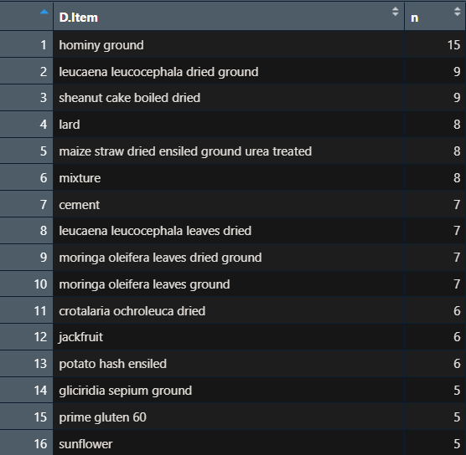
Ingredient classification
Most common unclassified ingredients
Only 90 unclassified items
Drops 73 unique papers

Slide 17
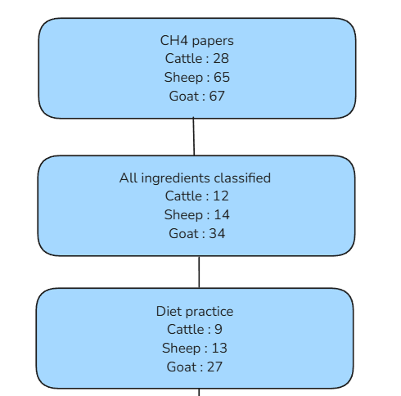
Practice classification logic
Compare treatments to control
Addition → totals increased OR only new ingredients added
Substitution → totals stable & increases ≈ decreases (flexibility ±3%)
5% threshold to show real diet change
Drops 11 papers because no control

Slide 18
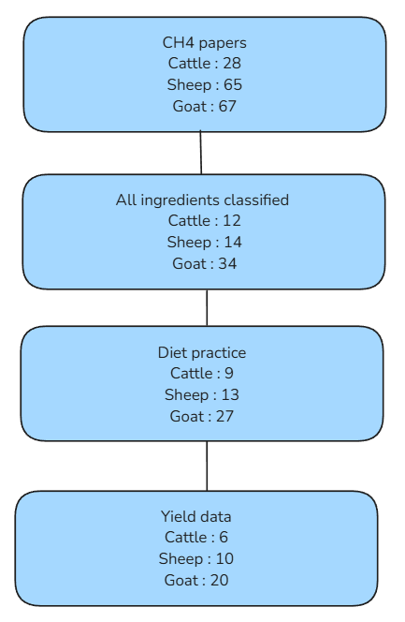
Emission intensity
Goal is to link emissions to productivity. Linking with meat and milk yield
Drops 13 papers because no yield data
ADG?

Slide 19
¡Gracias!

